Slide 1
微處理機系統 &微處理機系統實習

Slide 2
OakSim
https://github.com/Wunkolo/OakSim
https://wunkolo.github.io/OakSim/

Slide 3
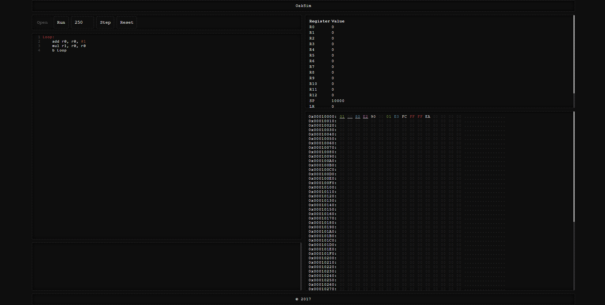

Slide 4
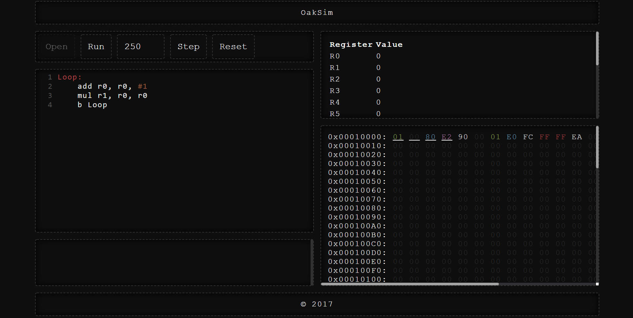

Slide 7
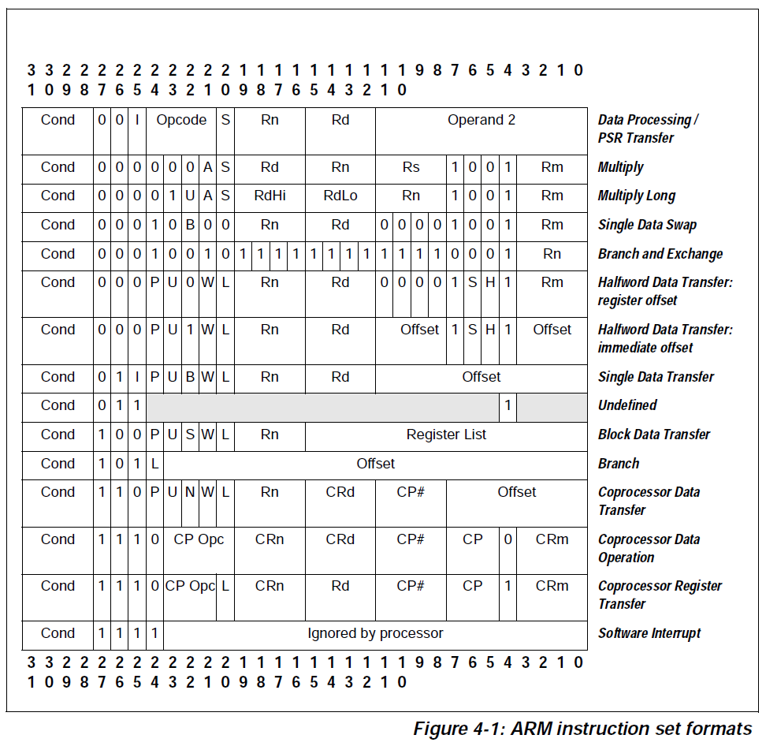

Slide 8
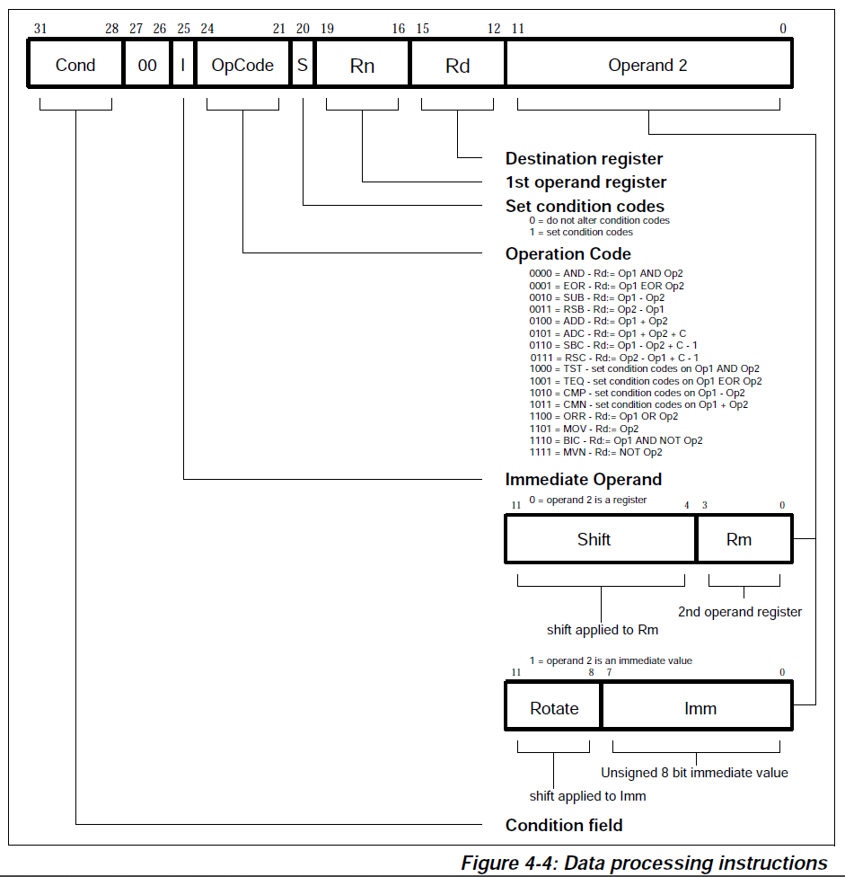

Slide 9
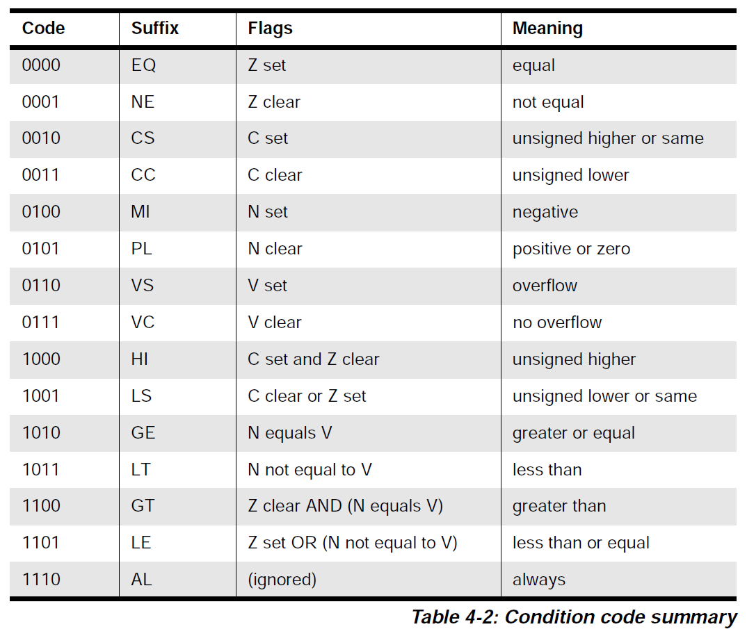

Slide 13
add r0, r0, #1 01 00 80 E2

Slide 14
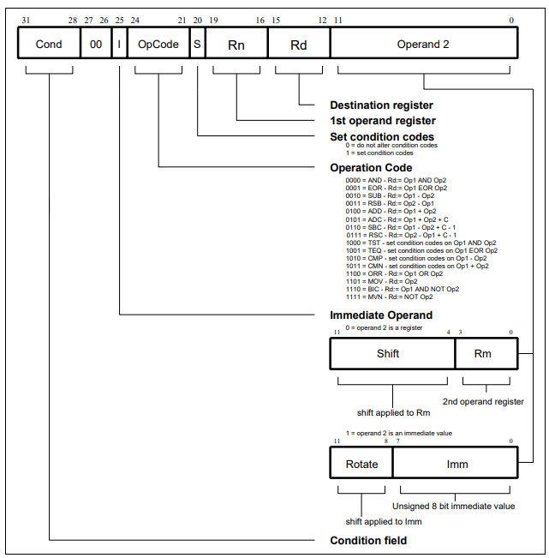
add r0, r0, #1

Slide 15
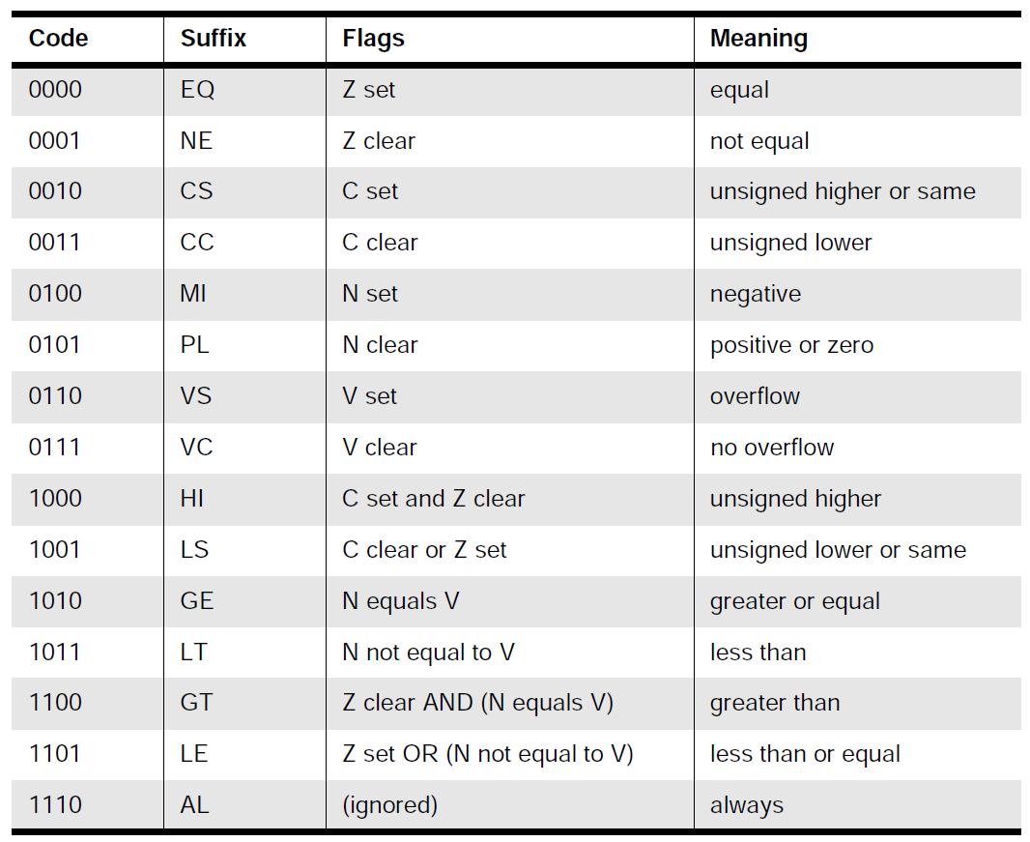

Slide 16
1110
add r0, r0, #1

Slide 17
1110
00
add r0, r0, #1

Slide 18
1110
00
0100
add r0, r0, #1

Slide 19
1110
00
0100
0
add r0, r0, #1

Slide 20
1110
00
0100
0
0000
add r0, r0, #1

Slide 21
1110
00
0100
0
0000
0000
add r0, r0, #1

Slide 22
1110
00
1
0100
0
0000
0000
add r0, r0, #1

Slide 23
1110
00
1
0100
0
0000
0000
add r0, r0, #1
0000

Slide 24
1110
00
1
0100
0
0000
0000
add r0, r0, #1
0000
00000001

Slide 25
1110
00
1
0100
0
0000
0000
0000
00000001
add r0, r0, #1

Slide 26
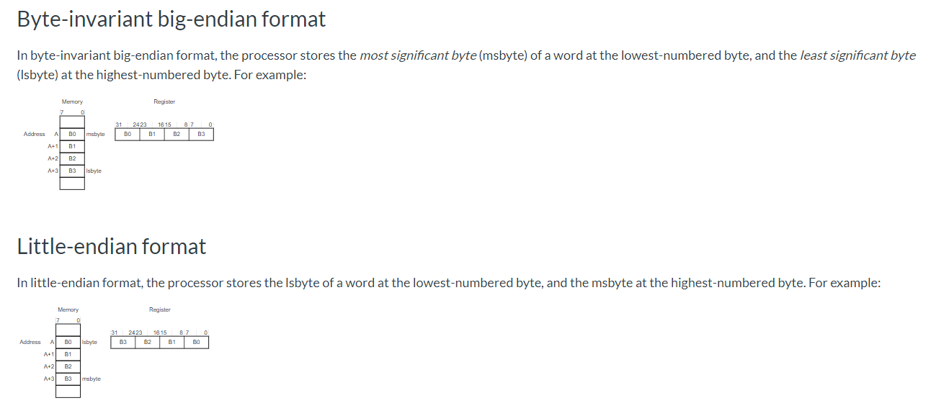
https://developer.arm.com/documentation/dui0497/a/the-cortex-m0-processor/memory-model/memory-endianness

Slide 28
1110
00
1
0100
0
0000
0000
0000
00000001

Slide 29
1110
00
1
0100
0
0000
0000
0000
00000001
1110 0010 1000 0000 0000 0000 0000 0001

Slide 30
1110
00
1
0100
0
0000
0000
0000
00000001
1110 0010 1000 0000 0000 0000 0000 0001
E
2
8
0
0
0
0
1

Slide 31
1110
00
1
0100
0
0000
0000
0000
00000001
1110 0010 1000 0000 0000 0000 0000 0001
E
2
8
0
0
0
0
1

Slide 32
1110
00
1
0100
0
0000
0000
0000
00000001
1110 0010 1000 0000 0000 0000 0000 0001
E
2
8
0
0
0
0
1

Slide 33
1110
00
1
0100
0
0000
0000
0000
00000001
1110 0010 1000 0000 0000 0000 0000 0001
E
2
8
0
0
0
0
1

Slide 34
1110
00
1
0100
0
0000
0000
0000
00000001
1110 0010 1000 0000 0000 0000 0000 0001
E
2
8
0
0
0
0
1

Slide 38
mul r1, r0, r0 90 00 01 E0

Slide 39
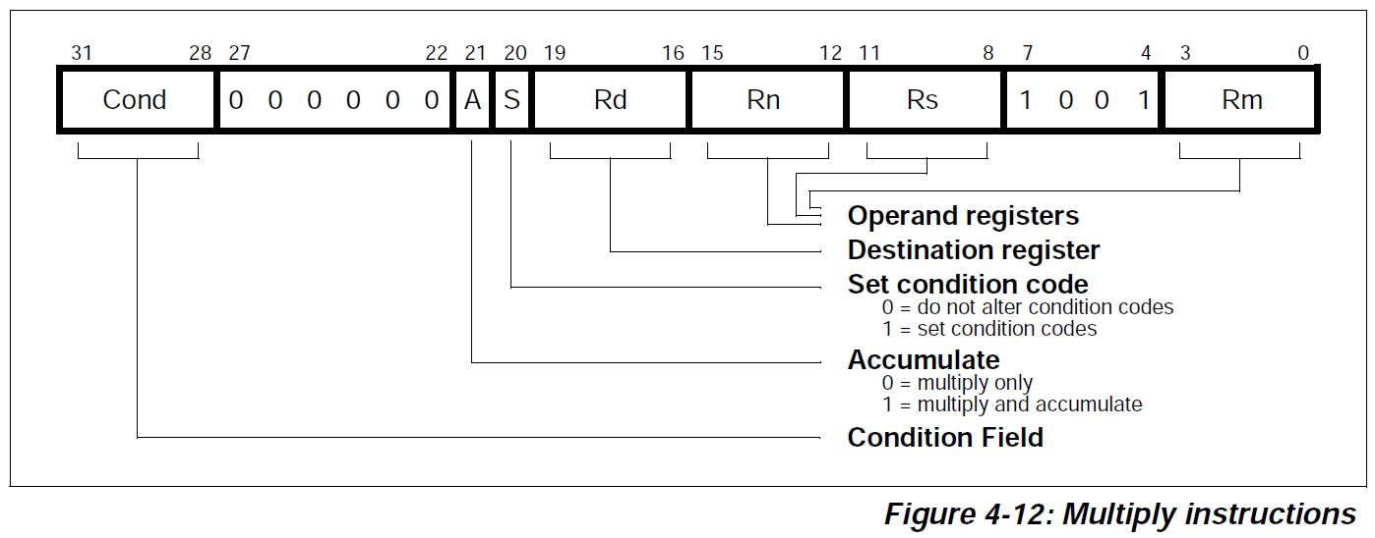

Slide 41
mul r1, r0, r0

Slide 42
mul r1, r0, r0
1110

Slide 43
mul r1, r0, r0
1110
000000

Slide 44
mul r1, r0, r0
1110
000000
0

Slide 45
mul r1, r0, r0
1110
000000
0
0

Slide 46
mul r1, r0, r0
1110
000000
0
0
0001

Slide 47
mul r1, r0, r0
1110
000000
0
0
0001
0000
The multiply form of the instruction gives Rd:=Rm*Rs. Rn is ignored, and should be set to zero for compatibility with possible future upgrades to the instruction set

Slide 48
mul r1, r0, r0
1110
000000
0
0
0001
0000
0000
0000
The multiply form of the instruction gives Rd:=Rm*Rs. Rn is ignored, and should be set to zero for compatibility with possible future upgrades to the instruction set

Slide 49
mul r1, r0, r0
1110
000000
0
0
0001
0000
0000
1001
0000

Slide 50
1110
000000
0
0
0001
0000
0000
1001
0000

Slide 51
1110
000000
0
0
0001
0000
0000
1001
0000
1110 0000 0000 0001 0000 0000 1001 0000

Slide 52
1110
000000
0
0
0001
0000
0000
1001
0000
1110 0000 0000 0001 0000 0000 1001 0000
E 0 0 1 0 0 9 0

Slide 53
1110
000000
0
0
0001
0000
0000
1001
0000
1110 0000 0000 0001 0000 0000 1001 0000
E 0 0 1 0 0 9 0
mul r1, r0, r0 90 00 01 E0

Slide 54
1110
000000
0
0
0001
0000
0000
1001
0000
1110 0000 0000 0001 0000 0000 1001 0000
E 0 0 1 0 0 9 0
mul r1, r0, r0 90 00 01 E0

Slide 55
1110
000000
0
0
0001
0000
0000
1001
0000
1110 0000 0000 0001 0000 0000 1001 0000
E 0 0 1 0 0 9 0
mul r1, r0, r0 90 00 01 E0

Slide 56
1110
000000
0
0
0001
0000
0000
1001
0000
1110 0000 0000 0001 0000 0000 1001 0000
E 0 0 1 0 0 9 0
mul r1, r0, r0 90 00 01 E0

Slide 57
1110
000000
0
0
0001
0000
0000
1001
0000
1110 0000 0000 0001 0000 0000 1001 0000
E 0 0 1 0 0 9 0
mul r1, r0, r0 90 00 01 E0

Slide 60
b loop FC FF FF EA
往上兩個指令
Branch instructions contain a signed 2’s complement 24 bit offset
This is shifted left two bits
The branch offset must take account of the prefetch operation, which causes the PC to be 2 words (8 bytes) ahead of the current instruction

Slide 61
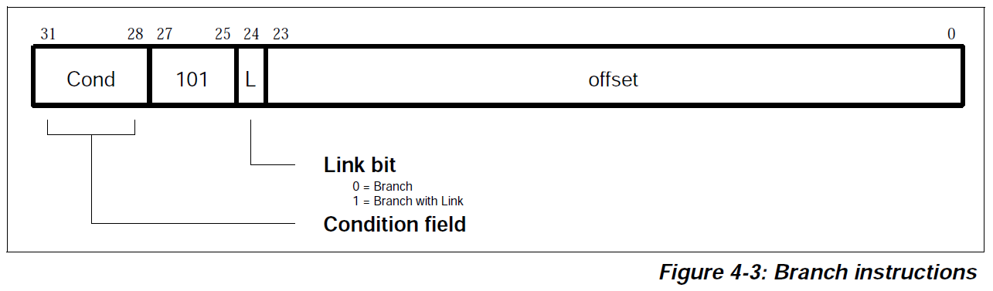
b loop

Slide 63
b loop
1110

Slide 64
b loop
1110
101

Slide 65
b loop
1110
101
0

Slide 66
b loop FC FF FF EA
往上兩個指令
Branch instructions contain a signed 2’s complement 24 bit offset
This is shifted left two bits
The branch offset must take account of the prefetch operation, which causes the PC to be 2 words (8 bytes) ahead of the current instruction

Slide 68
b loop FC FF FF EA
往上兩個指令
Branch instructions contain a signed 2’s complement 24 bit offset
This is shifted left two bits
The branch offset must take account of the prefetch operation, which causes the PC to be 2 words (8 bytes) ahead of the current instruction
-8

Slide 69
b loop FC FF FF EA
往上兩個指令
Branch instructions contain a signed 2’s complement 24 bit offset
This is shifted left two bits
The branch offset must take account of the prefetch operation, which causes the PC to be 2 words (8 bytes) ahead of the current instruction
-8
-16

Slide 70
b loop FC FF FF EA
往上兩個指令
Branch instructions contain a signed 2’s complement 24 bit offset
This is shifted left two bits
The branch offset must take account of the prefetch operation, which causes the PC to be 2 words (8 bytes) ahead of the current instruction
-8
-16
-16

Slide 71
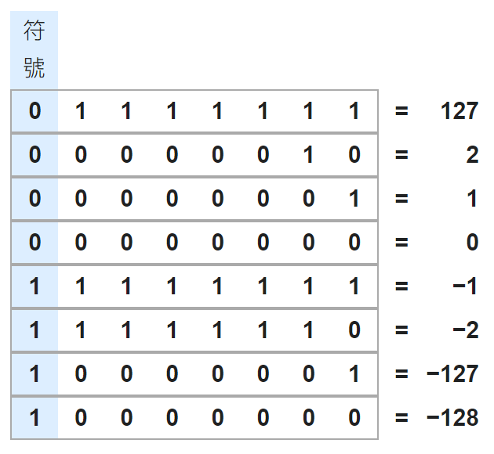
-16
16: 0001 0000
1110 1111
1111 0000
-16: 1111 0000

Slide 72
b loop FC FF FF EA
往上兩個指令
Branch instructions contain a signed 2’s complement 24 bit offset
This is shifted left two bits
The branch offset must take account of the prefetch operation, which causes the PC to be 2 words (8 bytes) ahead of the current instruction
-8
-16: 1111 0000
-16

Slide 73
b loop FC FF FF EA
往上兩個指令
Branch instructions contain a signed 2’s complement 24 bit offset
This is shifted left two bits
The branch offset must take account of the prefetch operation, which causes the PC to be 2 words (8 bytes) ahead of the current instruction
-8
-16: 1111 0000
-16 in simulation: 11 1100
-16

Slide 74
b loop
-16 in simulation: 11 1100
1110
101
0

Slide 75
b loop
-16 in simulation: 11 1100
1110
101
0
1111 1111 1111 1111 1111 1100
16: 00 0000 0000 0000 0000 0001 0000
11 1111 1111 1111 1111 1110 1111
11 1111 1111 1111 1111 1111 0000
11 1111 1111 1111 1111 1111 00
1111 1111 1111 1111 1111 1100
-16: 1111 1111 1111 1111 1111 1100

Slide 76
1110
101
0
1111 1111 1111 1111 1111 1100

Slide 77
1110
101
0
1111 1111 1111 1111 1111 1100
1110 1010 1111 1111 1111 1111 1111 1100

Slide 78
1110
101
0
1111 1111 1111 1111 1111 1100
1110 1010 1111 1111 1111 1111 1111 1100
E A F F F F F C

Slide 79
1110
101
0
1111 1111 1111 1111 1111 1100
1110 1010 1111 1111 1111 1111 1111 1100
E A F F F F F C
b loop FC FF FF EA

Slide 80
1110
101
0
1111 1111 1111 1111 1111 1100
1110 1010 1111 1111 1111 1111 1111 1100
E A F F F F F C
b loop FC FF FF EA

Slide 81
1110
101
0
1111 1111 1111 1111 1111 1100
1110 1010 1111 1111 1111 1111 1111 1100
E A F F F F F C
b loop FC FF FF EA

Slide 82
1110
101
0
1111 1111 1111 1111 1111 1100
1110 1010 1111 1111 1111 1111 1111 1100
E A F F F F F C
b loop FC FF FF EA

Slide 83
1110
101
0
1111 1111 1111 1111 1111 1100
1110 1010 1111 1111 1111 1111 1111 1100
E A F F F F F C
b loop FC FF FF EA

Slide 84


Slide 85
試試像本投影片一樣，說明以下題目
subeq r0, r1, #2 編碼結果為何? 以16進位表示
將上述流程儘可能詳細地用投影片表示

